Slide 1
Logic Microoperations

Slide 2

Logic Microoperations
Logic microoperations specify binary operations for strings of bits stored in registers.
These operations consider each bit of the register separately and treat them as binary variables.
For example, the exclusive-OR microoperation with the contents of two registers RI and R2 is symbolized by the statement
The exclusive-OR microoperation symbolizes the logic computation

Slide 3
Special symbols
For logic microoperations some special symbols are adopted.
The reason for adopting the special symbols is to be able to distinguish the symbols used in arithmetic microoperations.

Slide 4
Four basic microoperations
OR Microoperation
Symbol: ∨
Gate:
Example: 100110 ∨ 010110 = 110110

Slide 5
Four basic microoperations
AND Microoperation
Symbol: ∧
Gate:
Example: 100110 ∧ 010110 = 000110

Slide 6
Four basic microoperations
Complement (NOT) Microoperation
Symbol: ⁻
Gate:
Example: 1010110 = 0101001

Slide 7
Four basic microoperations
XOR (Exclusive-OR) Microoperation
Symbol: ⊕
Gate:
Example: 100110 ⊕ 010110 = 110000

Slide 8
Four basic microoperations
The + between R2 and R3 specifies an add microoperation.
The OR microoperation is designated by the symbol V between registers R5
and R6.

Slide 9
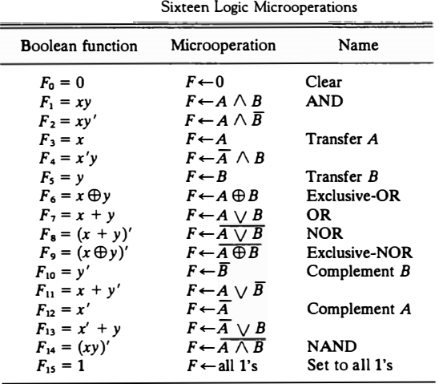
List of Logic Microoperations
There are 16 different logic operations that can be performed with two binary variables.
The Boolean functions listed in the first column represents a relationship between two binary variables x and y.
The logic micro-operations listed in the second column represent a relationship between the binary content of two registers A and B.

Slide 10
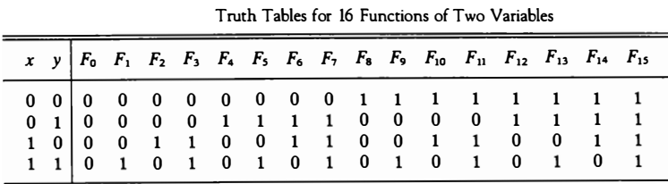
List of Logic Microoperations
The 16 different logic operations can be determined from all possible truth tables obtained with two binary variables.
Each of the 16 columns F₀ through F₁₅ represents a truth table of one possible Boolean function for the two variables x and y.

Slide 11
List of Logic Microoperations
Most computers use only four:- AND, OR, XOR, and complement operations to derive 16 logic microoperations.

Slide 12
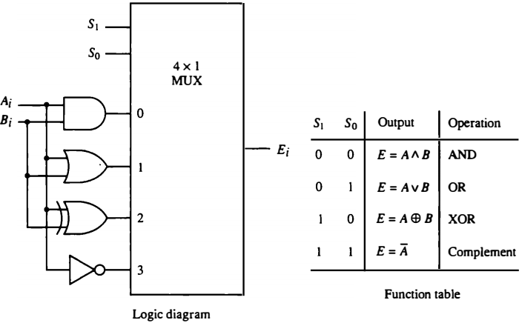
Logic Circuit
It consists of four gates and a multiplexer. Each of the four logic operations is generated through a gate that performs the required logic.
The two selection inputs S1 and S0 choose one of the data inputs of the multiplexer and direct its value to the output.

Slide 13
Some Applications
Logic micro-operations are very useful for manipulating individual bits or a portion of a word stored in a register.
They can be used to change bit values, delete a group of bits or insert new bits values into a register.

Slide 14

Selective-set operation
The selective-set operation sets to 1 the bits in register A where there are corresponding l's in register B. It does not affect bit positions that have 0's in B.
The OR microoperation can be used to selectively set bits of a register.

Slide 15

Selective-complement operation
The selective-complement operation complements bits in A where there are corresponding 1's in B. It does not affect bit positions that have 0's in B. For example:
The exclusive-OR microoperation can be used to selectively complement bits of a register.

Slide 16


Selective-clear operation
The selective-clear operation clears to 0 the bits in A only where there are corresponding l's in B. For example:
The corresponding logic microoperation is

Slide 17

Mask operation
The mask operation is similar to the selective-clear operation except that the bits of A are cleared only where there are corresponding O's in B. The mask operation is an AND micro operation as seen from the following numerical example:

Slide 18


Insert operation
The insert operation inserts a new value into a group of bits. This is done by first masking the bits and then ORing them with the required value.
For example, suppose that an A register contains eight bits, 0110 1010. To replace the four leftmost bits by the value 1001 we first mask the four unwanted bits:

Slide 19

Clear operation
The clear operation compares the words in A and B and produces an all 0's result if the two numbers are equal.
This operation is achieved by an exclusive-OR microoperation as shown by the following example

